Slide 1

Background Information Handout on Peace IV
June 2017
This handout is an updated version of public / community information sessions held in October and November 2016.
The powerpoint itself will not be used at the launch.
www.derrystrabane.com/Peace-IV

Slide 2

‘Top four FAQ’s’
What’s in the peace programme?
When is the money coming?
What’s in it for me/
my group?
What about Brexit?
www.derrystrabane.com/Peace-IV

Slide 3
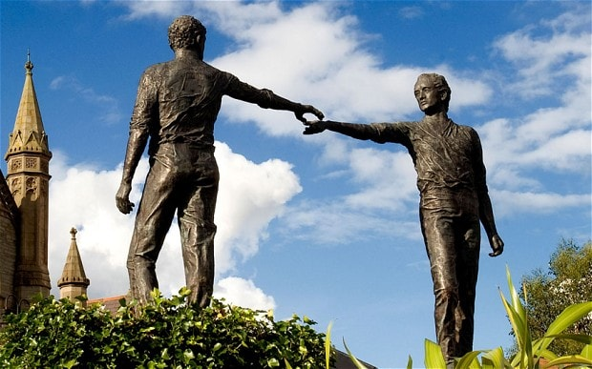
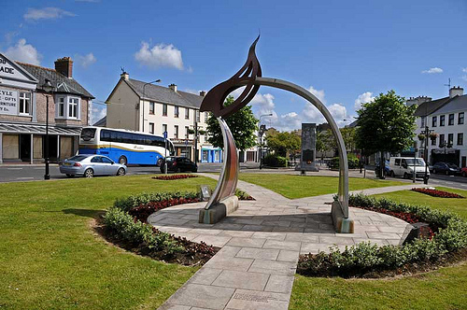
To get to this point has been over a 12 month process.
SEUPB Context/Background
DCSDC Consultation and Stage 1 Submission (June 2016)
DCSDC Development and Stage 2 Submission (September 2016)
Draft letter of offer (January 2017)
Letter of Offer and Permission to start
Launch (June 2017)
www.derrystrabane.com/Peace-IV

Slide 4
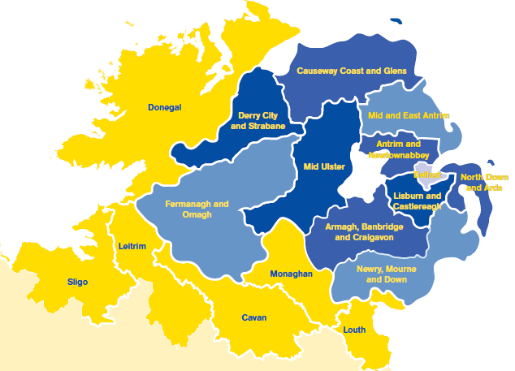
What is Peace IV?
Peace IV programme is an EU funded cross-border initiative
Financed by European Regional Development Fund (EU)
Managed by SEUPB (Special EU Programmes Body)
Designed to support peace and reconciliation in NI and the border region
Total value €270m (85% ERDF and 15% government match)
www.derrystrabane.com/Peace-IV

Slide 5
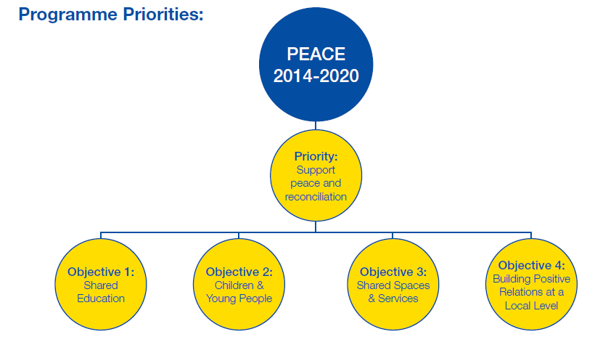
Which bit of Peace IV are we talking about?
Specific Objective 4.1 Local Authority Action Plans
17 Action Plans Across Eligible Region
Allocation based on per capita and deprivation
Total Value €35.3m
Council Programmes had to be aware not to clash with other areas of PEACE IV funding. Eg. Council programmes cannot include Early Years work or schools work (unless extra-curricular).
Community and other organisations were welcome to apply to other areas of PEACE IV funding directly in their own right.
www.derrystrabane.com/Peace-IV

Slide 6


What types of things does 4.1 ‘Building positive relations at a Local Level’ have to do?
  Specific Objective:
  The promotion of positive relations characterised by respect and where cultural diversity is celebrated and people can live, learn and socialise together, free from prejudice, hate and intolerance.
    Activities will focus on developing strong inclusive civic leadership that promotes positive relationships, encourages dialogue, and supports practical efforts to bring about change between individuals and communities.
    Initiatives should evidence commitment to tackling real and complex issues, such as sectarianism and racism.
www.derrystrabane.com/Peace-IV

Slide 7
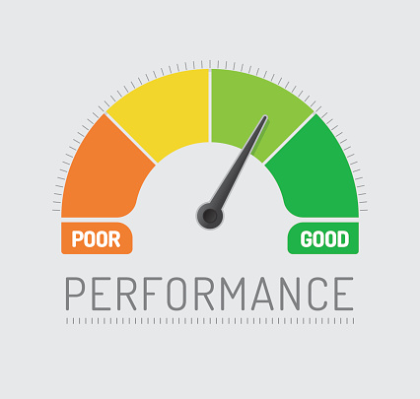
Building Positive Relations - SEUPB Overall Result of programme:
  Result:
  An increase in the % of people who think relations between Protestants and Catholics are better than they were five years ago, from 45% to 52%;
  The % of people who think relations between Protestants and Catholics will be better in 5 years (from 40% to 48%)
  The % of people who know about the culture of minority ethnic communities from 30% to 38%
www.derrystrabane.com/Peace-IV

Slide 8

Results and Outcomes across 3 key themes:
1. Children and Young People
2. Shared Spaces and Services
3. Building Positive Relations at a local level
www.derrystrabane.com/Peace-IV

Slide 9
Peace IV Allocation
DCSDC
€7,964,210 £6,783,131.00
Shared Spaces
€2,484,960
£2,166,444
Building Positive Relations
€3,042,760
£2,591,524
Flat rate Technical Assistance
Salaries £715,269
Overheads £107,290
Children and Young People €1,470,707 £1,252,604
Overall objective:
To promote positive relations characterised by respect, where cultural diversity is celebrated and people can live, learn and socialise together, free from prejudice, hate and intolerance.
Horizontal Principles: Sustainable Development and Equal Opportunities
Cross-Community
Cross-Border
www.derrystrabane.com/Peace-IV

Slide 10

SEUPB: Children and Young People
Objective: Enhancing the capacity of children and young people to form positive and effective relationships with others from a different background and make a positive contribution to building a cohesive society. In particular, young people who are most disadvantaged and hardest to reach will benefit from the investment.
Action plans to target age 0-24 years with good relations interventions.
Programmes to invest in children and young people to reach their potential and contribute to a cohesive society.
Good Relations interventions to reduce community division, sectarianism and racism, and enhance reconciliation.
Citizenship interventions to develop participants capacity to positively contribute to family, community and society
www.derrystrabane.com/Peace-IV

Slide 11

SEUPB: Shared Spaces and Services
Objective: To create a more cohesive society through an increased provision of shared spaces and services.
Action Plan programmes to include:
New shared civic spaces transforming local areas;
Developing sharing of existing neighbourhoods, public spaces and buildings.
Change reflected in impact of Parades, flags, emblems, graffiti and related issues on public space and positive attitudes and behaviours relating to reducing segregation.
Interfaces, contested spaces, programming in new shared spaces
www.derrystrabane.com/Peace-IV

Slide 12

SEUPB:Building Positive Relations
Objective: The promotion of positive relations characterised by respect, and where cultural diversity is celebrated and people can live, learn and socialise together, free from prejudice, hate and intolerance.
Action Plan Programmes to include:
Actions to facilitate the full participation of women
Targeting groups particularly impacted by the legacy of the troubles/conflict (eg. victims and survivors, communities with social low capital,
Groups/networks dealing with specific legacy issues (eg.young and older people, women, the faith community, victims and survivors, those with disability from the legacy of violence, ex-prisoners, former security force members.)
Can include sports, arts, culture, decades of commemorations, leadership programmes etc
www.derrystrabane.com/Peace-IV

Slide 13

What counts as a participant?
‘Sustained purposeful cross-community contact of 26 hrs across 6 months or more.’
2060 children and young people
1260 under shared spaces
1548 under building positive relations
All projects are strongly cross-community:
 | CNR | PUL | BME/Other
Actual Population | 72% | 25% | 2%
Peace IV Programme Target | 48% | 48% | 4%
www.derrystrabane.com/Peace-IV

Slide 14

What went into Stage 1 submission June 2016
Executive Summary
Strategic & Policy Context
Need & Demand
Options Analysis
The Action Plan
Budget & Financial Projections
Risk Analysis
Management Arrangements
Monitoring and Evaluation
Horizontal Themes
Communications/Marketing
Exit Strategy
The submission was based on the public consultation from March – June 2016.
Consultation included 42 sessions including 7 public events, 180 participants, 10 statutory agencies and direct written responses submitted.
www.derrystrabane.com/Peace-IV

Slide 15
DCSDC Consultation and Stage 1 Submission
Local Peace IV Plan is based on:
Achievements/Learning from Peace III
Current regional and local strategies and policies
Community Planning
Preliminary consultation with statutory, community and voluntary, networks, special interest groups.
Online consultation and public workshops
April - June 2016
www.derrystrabane.com/Peace-IV

Slide 16
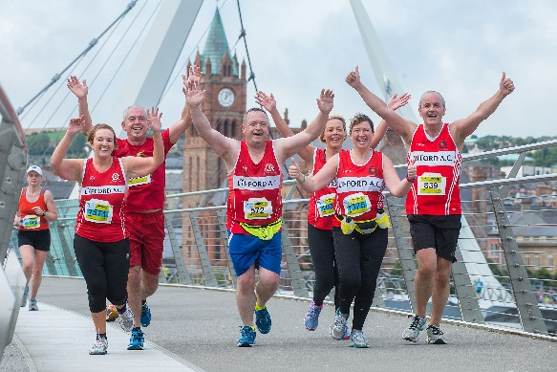
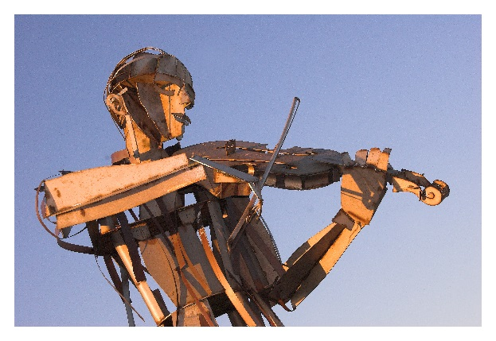
Local Vision and Strategic Aims
Guiding Vision
By 2023 Derry and Strabane will be a peaceful and shared society where good relations is embedded, our communities inclusive and connected and where all cultures and traditions are respected.
Strategic Aims
Supporting and responding to the needs of our children and young people so that they can fully realise their potential and maximise their contribution to a cohesive society.
Making public spaces, across the region, more inclusive, welcoming and connected
Building the capacity within society to deal positively with diversity and difference.
www.derrystrabane.com/Peace-IV

Slide 17
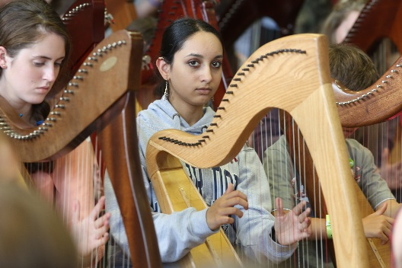
Stage 1: 6 Indicative Actions under Children and Young People:
Early Intervention Programmes
(Early Years/Intergenerational)
Marginalised Youth (Wellbeing)
Youth Participation and Democracy
Youth Leaders and Citizenship
Skills/Learning Pathways for Youth
Pilot Youth Zone (Research)
www.derrystrabane.com/Peace-IV

Slide 18
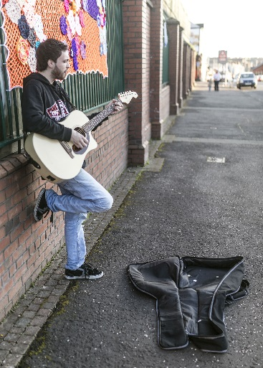
Stage 1:
4 Indicative Actions under Shared Spaces
Developing/Enhancing Shared Spaces
Utilising Natural Connections
Interface Investment Programme
Transforming Contested Spaces (finding solutions to sensitive issues/community tensions)
www.derrystrabane.com/Peace-IV

Slide 19
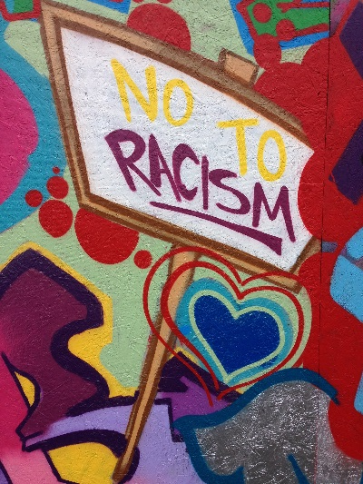
Stage 1: 7 Indicative Actions under Building Positive Relations
‘One Community’ Programme
Exploring Identity through heritage, culture, history
Decade of Commemorations
Unheard Voices
Patriarchy in post-conflict society
Cohesive Neighbourhoods – BME, LGBT, minorities.
Leadership Co-operation Programme
www.derrystrabane.com/Peace-IV

Slide 20

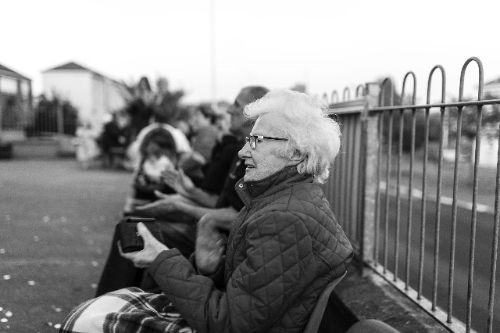
Assessing the impact
Monitoring and Evaluation Framework
Results set at government level under each priority.
Assessed through NI Life and Times Survey
Locally developed monitoring and evaluation framework required measuring DCSDC PEACE Plan objectives and SEUPB programme specific results.
Also contribute to Community Plan.
To assess levels of engagement, participation, collaboration, impact on individuals. Eg. Connection with shared civic spaces; confidence in accessing diverse services/locations; increased sense of belonging;
To assess change in knowledge and skills; attitudes and behaviour. Eg. Increased awareness/respect for diversity; knowledge of rights and responsibilities; enhanced employability.
www.derrystrabane.com/Peace-IV

Slide 21
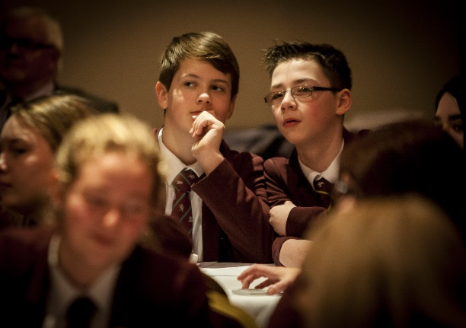
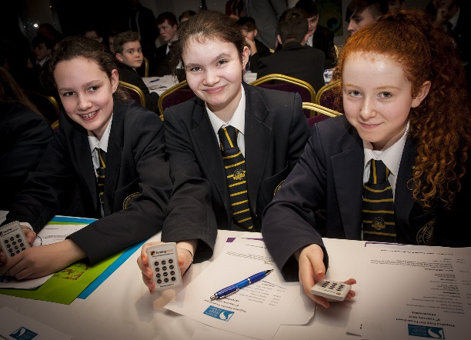
Children and Young People - results
An increase in the percentage of 16 year olds who socialize or play sport with people from a different religious community ‘very often’ from 43% to 50%, ‘sometimes’ from 24% to 28%.
An increase in the percentage of 16 year olds who think relations between Protestants and Catholics are better than they were five years ago from 45% to 50%.
An increase in the percentage of 16 year olds who think relations between Protestants and Catholics will be better in five years’ time from 38% to 45%.
www.derrystrabane.com/Peace-IV

Slide 22
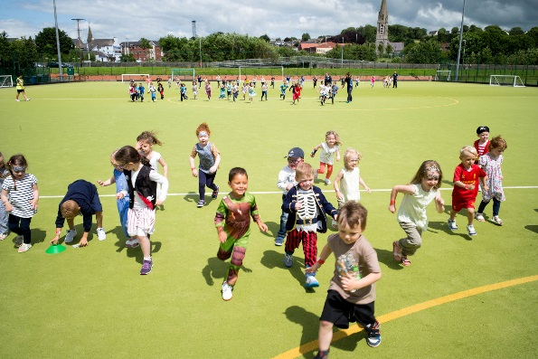
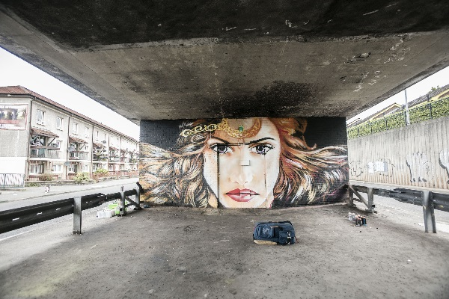
Shared spaces and services - results
The percentage of people who would define the neighbourhood where they live as neutral; from 64% always or most of the time to 68%, and from 22% sometimes to 26%.
The percentage of people who would prefer to live in a neighbourhood with people of only their own religion; from 20% to 16%.
The percentage of people who prefer to live in a mixed religion environment; from 71% to 75%.
www.derrystrabane.com/Peace-IV

Slide 23
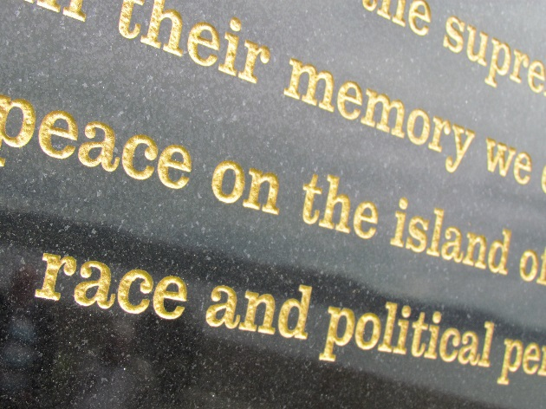
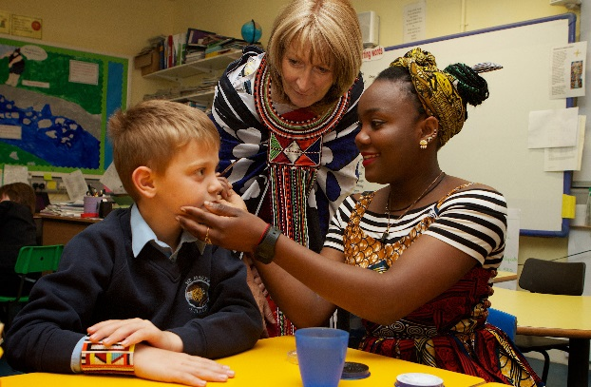
Building Positive Relations - Results
An increase in the percentage of people who think relations between Protestants and Catholics are better than they were five years ago from 45% to 52%.
An increase in the percentage of people who think relations between Protestants and Catholics will be better in five years’ time from 40% to 48%.
An increase in the percentage of people who know quite a bit about the culture of some minority ethnic communities from 30% to 38%.
www.derrystrabane.com/Peace-IV

Slide 24

DCSDC Development and Stage 2 Submission
SEUPB Positive Feedback Stage 1
July – September 2016
Developing detail on 17 Indicative Actions
Phased approach due to Brexit (This was later changed and the original full timescale confirmed).
Completion of Business Plan and workplans
Meetings key stakeholders and officers
Plan endorsed by council Oct 16
Plan endorsed by Board at its inaugural meeting
www.derrystrabane.com/Peace-IV

Slide 25
The following slides list the programmes.
Note that two programmes originally applied for were not funded ultimately by SEUPB.
There will therefore be a re-bid process for the remaining funding. The timescale for this re-bid will be clarified in the near future but the outline of the re-bid programmes are included for information anyway at this point as they are already approved by the Board and council.
The figures included in these slides are the original bid figures. These are likely to change slightly in the actual letter of offer.
www.derrystrabane.com/Peace-IV

Slide 26
Children and Young People
Intervention | Summary | Budget | Delivery*
Marginalised Youth (Wellbeing) | 15-24 year olds multi-agency programmes positive attitudes and behaviours physical, mental, emotional wellbeing. | £198,444 | Lead Partner
Youth Participation and Democracy | Development of a structure and associated training/workshops for youth influence on public sector. | £264,000 | Lead Partner
Youth Leaders and Citizenship | Cultural intervention programme for youth ‘at risk’. Youth Officer, research ‘Response Unit’, youth charter and peer leaders. | £351,048 | Lead Partner
Skills/Learning Pathways for Young People | Training programme bridging unemployment and world of work paid work placements and accredited training. | £297,000 | Lead Partner
Pilot Youth Zone | Research into centralised youth zone within Derry~Londonderry. | £20,000 | Lead Partner
www.derrystrabane.com/Peace-IV

Slide 27
Children and Young People (contd)
Intervention | Summary | Budget | Delivery*
Re-bid Cross-community youth programme | Cross-community programme working with 121 11-13 year olds. 3 areas: Derry~Londonderry and Donegal Cross Border area Derg (and Donegal cross-border area) Sperrin and Faughan (including Strabane Town and Lifford) Programme must include age appropriate residential, day trips, peace and reconciliation, diversity content. | £60,000 | Tender
Re-bid Cross-community childrens’ programme | Cross-community programme working with 8-11 year olds. Programme must include age appropriate day trips, peace and reconciliation, diversity content. | £62,112 | Tender
None of our work is allowed to be schools based – it must all be extra-curricular and not during school hours if pupils are involved.
www.derrystrabane.com/Peace-IV

Slide 28
Shared Spaces and Services
Intervention | Summary | Budget | Delivery
Shared Space: Castlederg | Riverside area connecting GAC and FC – physical works and wider social and sports programme activity. | £293,000 | Lead Partner
Shared Space: St.Columb’s Park Walled Garden | Walled Garden space physical regeneration and wider programme of social, heritage and environmental activity. | £373,444 | Lead Partner
Shared Space: Waterside Shared Village | Cross-interface Top of the Hill/Irish Street. Programme of activity. (Parallel with Capital Development Application) | £500,000 | Tender
Natural Connections: Peace Tourism | Peace Tourism Officer. Co-ordinate PUL, CNR, BME community tourism and wider tourism to produce, pilot and promote package ‘conflict, reconciliation and beyond’ | £336,805 | Lead Partner
Interface Investment Programme | Cross-community cross-interface programme activities Tullyally/Currynierin, Irish Street/Top of the Hill, Fountain/Bishop Street | £237,000 | Tender
Contested Space: Bonfires | Focused around DCSDC bonfires working group. CS Officer phase 1 6 bonfire sites, phase 2 all remaining sites. | £156,805 | Lead Partner
Re-bid: Shared Space Programme | 4 Areas: 1. Castlederg (and surroundings) 2. Bonds St/Triangle/Shepherds Glen 3. Strabane (and surroundings) 4. Newtownstewart (and surroundings) | £219,390 | Tender (4 lots)

Slide 29
Building Positive Relations
Intervention | Summary | Budget | Delivery
One Community | Employ officer to mainstream GR across 8 Local Community Plans tackling localised GR issues. £150K for programmes. | £316,805 | Lead Partner
Identity: Cross-cultural strategic initiative | Strategic Link/sustained partnership working/dialogue and shared space/programming between Irish, Ulster-Scots and Marching bands identities. | £191,805 | Tender
Identity: Riverine | Strabane/Lifford Cross-community, cross-border environmental stewardship programme riverside greenways/parkland (Parallel with Capital Development Application) | £115,000 *re-bid may increase | Lead Partner
Identity: Sport | Clubs/participants wide geographical area diversity, reconciliation, cross-community contact. Training, summer camps, soccer/rugby/GAA community festivals. | £188,000 | Lead Partner
Decade of Commemorations | Inclusive ethical response to commemorations. 2 exhibitions (2018 WW1/General Election; 2020 Partition, NI formation). Community and schools programme including digital elements. | £250,000 | Tender
Unheard Voices | Programme engaging unheard and dissenting voices, storytelling and dialogue, conferences, workshops, seminars. | £158,000 | Tender

Slide 30
Building Positive Relations (contd.)
Intervention | Summary | Budget | Delivery
Patriarchy | Programme/Resource Manual around gender based violence and peace building. Empowerment. | £130,000 | Tender
Cohesive neighbourhoods: BME, LGBT, Minorities | Foyle Racial Equality Forum; Anti-prejudice Schools campaign; Governance/Capacity Development; Advice Services Mainstreaming; Intercultural pairing. | £215,000 | Tender
Cohesive neighbourhoods: Small Grants | 10-16 grants where tendered approach less viable and key issues eg. Political ex-prisoners, victims/survivors, political demarcation, punishment attacks, festivals. | £500,000*re-bid may increase | Small Grants
Leadership: Youth/Schools Trainers | Training programme reaching educators of 11-24 age group on racism, sectarianism, homophobia, legacy. | £25,000 | Tender
Leadership: Marginalised Young Adults | Structured volunteering 16-25 year olds at risk anti-social behaviour; social action projects, anti-prejudice, mobility to shared spaces, community planning engagement. | £340,883 | Tender
www.derrystrabane.com/Peace-IV

Slide 31

Peace IV Strategic Partnership Board
An unincorporated body (Open Call for social partners)
Responsible for overall management/delivery of the council & SEUPB approved PEACE IV programme and finances.
32 board members across three strands
Elected representatives (12), statutory/public sector agencies (8) and social partners (12).
Social Partners: Anne McTaggart, Maureen Hetherington, Agnieska Luczak, William Lamrock, Paul Gallagher, Teresa Stewart, Conal McFeely, Gearóid Ó hEára, Alison Wallace, Catherine Cooke, Margaret McLaughlin, Darren O’Neill.
Elected Members: 6 SF, 3 SDLP, 3 DUP
Statutory Agencies: NIHE, DEARA, Dept of Communities, PSNI, EA, (Western Division), Youth Justice, WHSCT, NWRC
www.derrystrabane.com/Peace-IV

Slide 32
Partnership Board & Steering Groups
Partnership has 3 thematic steering groups (monthly) to assist in the development, co-ordination and ongoing review of each of the themes.
Additional Operational Steering group responsible for monitoring spend, progress, claims, risk identification and mainstreaming learning towards end of programme etc.
Derry and Strabane PEACE IV
Partnership
Operational
Steering Group
Children and Young People Steering Group
Shared Spaces Steering Group
Building Positive Relations Steering Group
www.derrystrabane.com/Peace-IV

Slide 33
Peace IV Management Staffing
Programme Manager (PEACE): Sue Divin
Project Officer: Mary Claire Kerlin
Project Officer: Fiona Lafferty
Finance, Administration and Verification Officer: Jennifer Coyle
www.derrystrabane.com/Peace-IV

Slide 34

What delivery mechanisms were open to us?
Partner Delivery
Lead Partner*
Board Member**
2. Tenders
Small Grants
*Where DCSDC is lead council officers lead the programme but follow standard procurement which may mean tender opportunities still arise.
** DCSD Council opted not to use the Board Member Partner Delivery mechanism due to consultation feedback.
www.derrystrabane.com/Peace-IV

Slide 35

Timescales for delivery
Approximately 3.5 year delivery ‘on the ground’
Start July 2017
Close of spend on programme December 2020
Won’t all begin at exactly the same time.
www.derrystrabane.com/Peace-IV

Slide 36
What counts as a participant?
‘Sustained purposeful cross-community contact of 26 hours spread over 6 months or more.’
2060 children and young people
1260 under shared spaces
1548 under building positive relations
Every project will have a number of participants to reach. A participant must have done the start and end project questionnaire and been involved for the whole project.
www.derrystrabane.com/Peace-IV

Slide 37


Timeframes
June 2016: Stage 1 submission.
Sept 2016: Stage 2 submission.
Oct 2016: Briefings with elected members, statutory and social partners, key council staff, community/public.
Nov 2016: Initial Partnership Board
Dec 2016: Initiation recruitment for PIV secretariat
Dec 2016: Initial Steering groups meetings
Jan 2017: Draft LOO from SEUPB
Feb 2017: Initiation of monthly e-bulletins via website
Feb – Jun 2017: Public Ad of series of tenders
May – Jun 2017: Initiation of recruitment for programme staff.
June 2017: Formal Launch
www.derrystrabane.com/Peace-IV

Slide 38
How can I get involved?
www.derrystrabane.com/Peace-IV

Slide 39


Two questions. Two ways of thinking.
Can my group get money?
Can my group benefit from the money?
www.derrystrabane.com/Peace-IV

Slide 40


Tenders
Consider Tendering if you wish
Consider partnership approaches to tendering
Consider providing a letter of support to other groups tendering
Consider what is realistic for the size and experience of your organisation
www.derrystrabane.com/Peace-IV

Slide 41
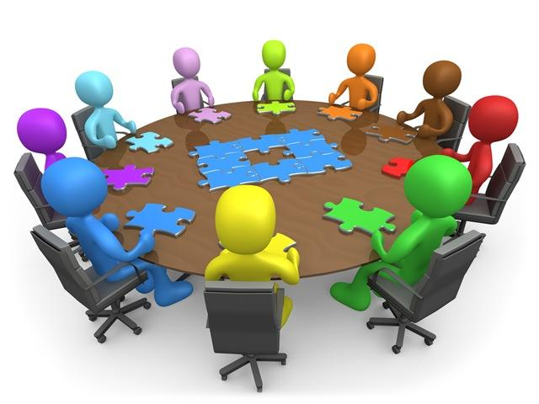
Project Steering Group Opportunities
Many project will have to form a project steering group – they may want geographical, identity based involvement and thematic expertise.
This is our way of building in wider community participation, engagement and benefit.
It means communities can engage but not face the bureaucracy.
Steering groups must be balanced, cross-community and representative of a wide range of identities.
Watch out for these opportunities as well as tenders and grants.
www.derrystrabane.com/Peace-IV

Slide 42

Encourage individuals to take part.
Encourage individuals to sign up to the e-newsletter.
Spread the word of project opportunities to your members.
Consider helping to recruit individuals into participating if interested.
www.derrystrabane.com/Peace-IV

Slide 43

Grants – September 2017. Quite Specific.
  There are 5 specific programme criteria:
Projects with those most impacted by the Troubles
Removal/Re-imaging of permanent political demarcation of territory
Community Education/Programmes to tackle culture of punishment attacks
Programmes intensively tackling reconciliation issues not covered in depth elsewhere in the local PEACE IV programme
Cross-community programmes with strong reconciliation focus in geographical areas of DCSDC not already named in other PEACE IV local programmes and which work with participants who have not previously engaged significantly in cross-community work.
www.derrystrabane.com/Peace-IV

Slide 44
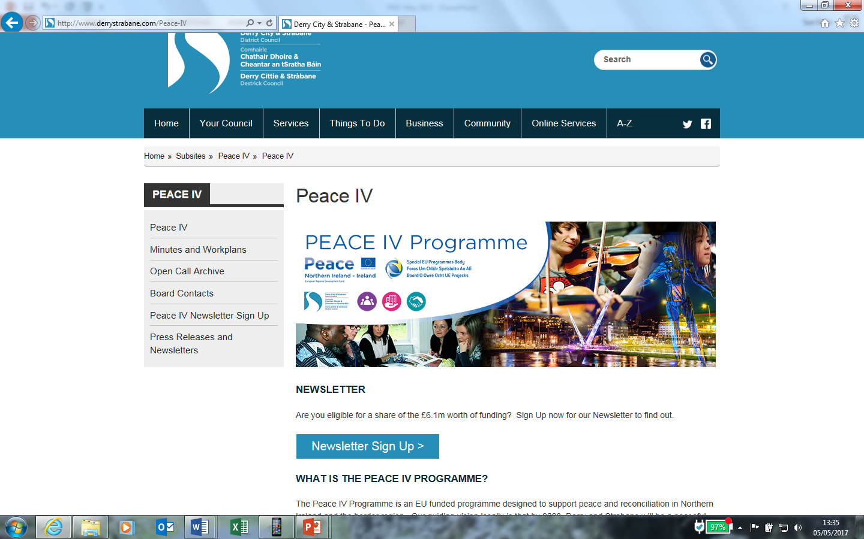
Please sign up for our monthly e-newsletter
www.derrystrabane.com/Peace-IV

Slide 45

peace@derrystrabane.com
Tel: 02871253253
This information is available upon
request in a number of formats including
large print, Braille, PDF, audio formats
(CD, MP3, DAISY) and minority languages.
telephone: 028 71 253 253
text phone: 028 7137 6646 or
e-mail: equality@derrycityandstrabanedistrict.com
www.derrystrabane.com/Peace-IV

